Slide 1
Missions Communication
Howard Culbertson

Slide 2
"God cannot lead you on the basis of information you do not have"
— Ralph Winter, missiologist

Slide 3
“The Nazarene denomination has done a good job of creating tools to get the word out about missions and the missionaries, but I wonder how well we are using these tools.” – Chris Thomas, Grace Church of the Nazarene, Columbia, TN

Slide 4
“I love to read the children’s mission books to my children. The stories within them ignite my children’s curiosity about missions and missionaries. Those stories also begin to stir in their hearts a passion for reaching the lost.” – Katie Crowe, Children’s Pastor, Church of the Nazarene, Independence, KS

Slide 5
Newsletters and videos from Regions and fields

Slide 6
Prayer letters and blogs from missionaries

Slide 7
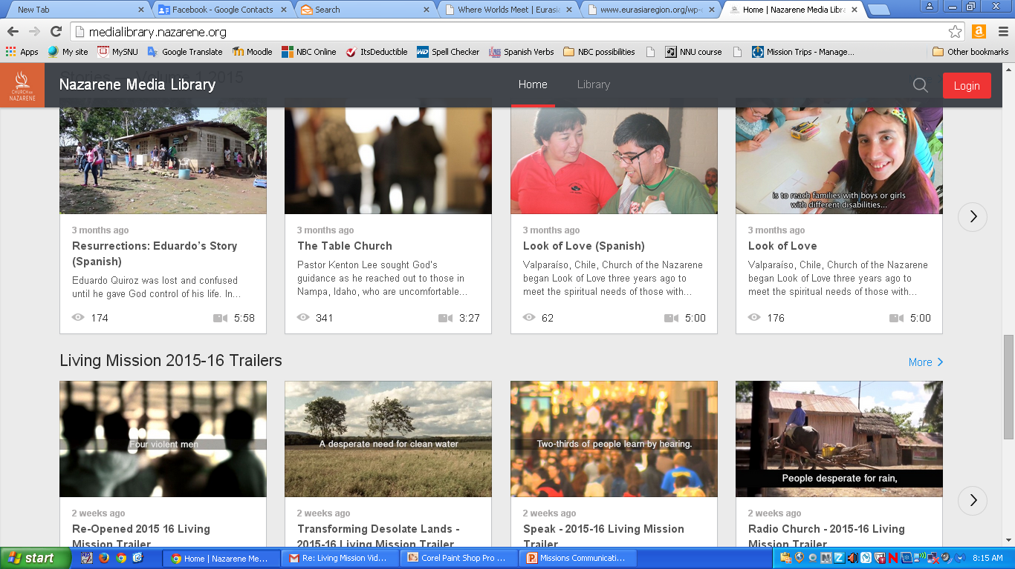
Videos on Global Ministry Center site

Slide 8
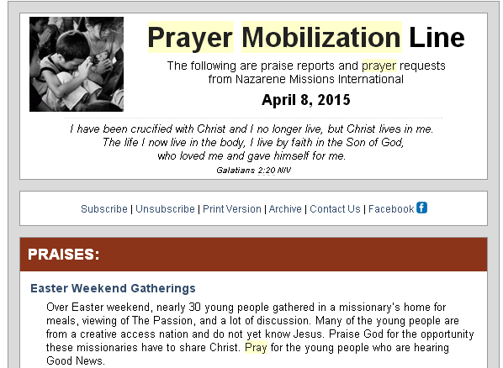

Slide 9
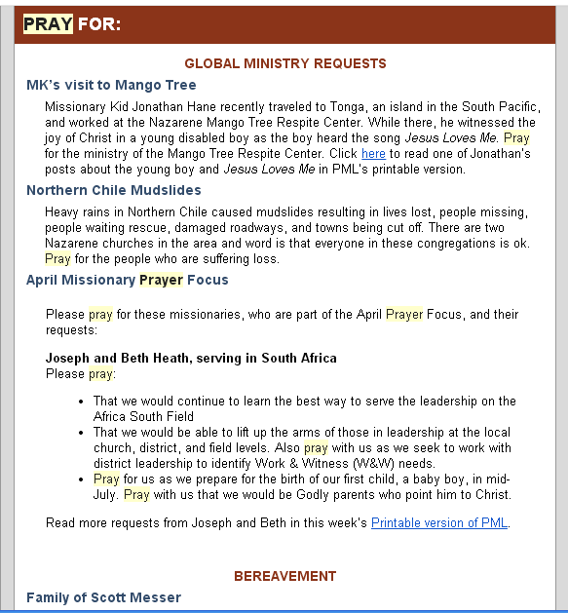

Slide 10
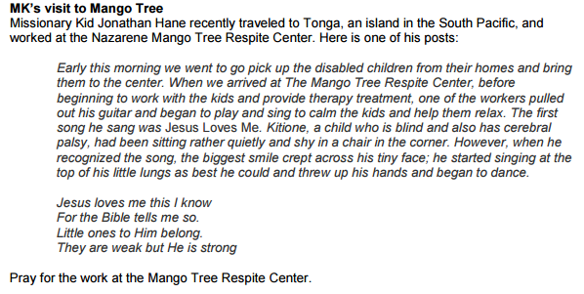
From “printable” version of PML

Slide 11



Slide 12



Slide 13



Slide 14
Living Mission: Where the Church is Not yet
The 12 lessons and 2 CAUSEs in this year’s Living Mission are compilations of stories and highlights from the six regions of the Church of the Nazarene, as gathered by the Asia-Pacific communications team.

Slide 15
Living Mission: Where the Church is Not yet
12 lessons and 2 CAUSEs (each with 9 sessions) incredible stories,
testimonies,
and video segments
of how the church has crossed closed borders, entered closed communities,
impacted lives,
and brought the hope and love of
Christ to those who were searching.

Slide 16
Living Mission: Where the Church is Not yet
Will stir your people’s praise as they see evidence of God at work through the global outreach of the church
Will stir your congregation’s passion to do their part to fulfill the denominational mission to “make Christlike disciples in the nations”

Slide 17
"God cannot lead you on the basis of information you do not have"
— Ralph Winter, missiologist

Slide 18
This PowerPoint presentation is available along with related materials and other PowerPoint presentations at http://home.snu.edu/~hculbert/ppt.htm

