Slide 1
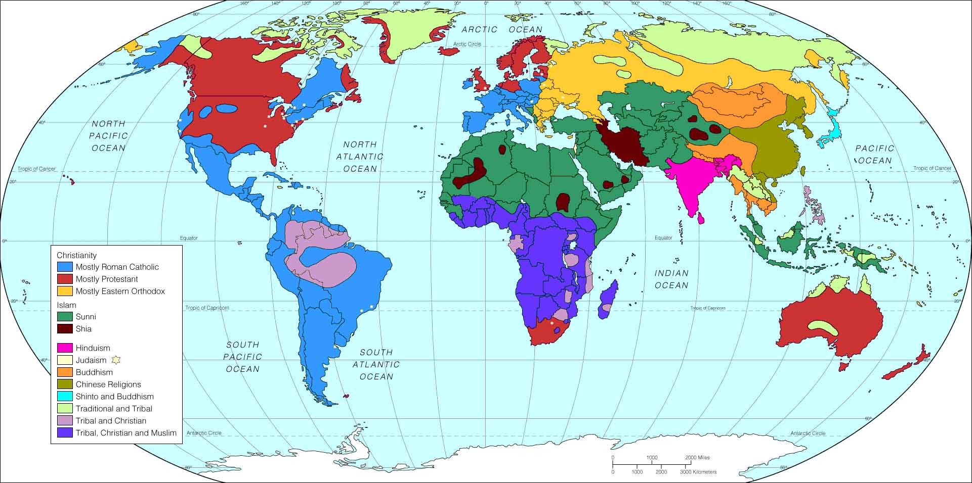
Dominant Religions

Slide 2
This PowerPoint slide is available along with related materials and other PowerPoint presentations at htps://home.snu.edu/~hculbert/ppt.htm

