Slide 1
Missions visualized in Scripture
Howard Culbertson
Southern Nazarene University

Slide 2
How many times does the book of Hebrews and all the letters of Paul, John, Peter, James and Jude quote Jesus’ Great Commission?

Slide 3
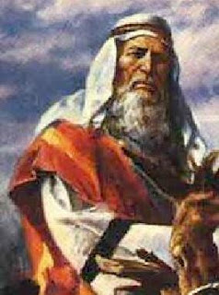
All peoples on earth will be blessed through you – Genesis 12
Graphic: http://newundersol.blogspot.com

Slide 4
Genesis 12:1-3
The LORD had said to Abram, "Leave your country, your people and your father's household and go to the land I will show you
"I will make you into a great nation
and I will bless you;
I will make your name great,
and you will be a blessing.
I will bless those who bless you,
and whoever curses you I will curse;
and all peoples on earth
will be blessed through you.“

Slide 5
Not just Abraham
"I am the LORD, the God of your father Abraham and the God of Isaac. I will give you and your descendants the land on which you are lying. Your descendants will be like the dust of the earth, and you will spread out to the west and to the east, to the north and to the south. All peoples on earth will be blessed through you and your offspring.”
  Genesis 28:13-14

Slide 6
Implications?
“Understand, then, that those who believe are children of Abraham. The Scripture foresaw that God would justify the Gentiles by faith, and announced the gospel in advance to Abraham: ‘All nations will be blessed through you.’ So those who have faith are blessed along with Abraham, the man of faith.” (Galatians 3:7-9)

Slide 7
It’s been said that we are “blessed” in order that we will be a “blessing”
Thus, “top-line blessings” bring “bottom-line responsibilities” (Bob Sjogren)

Slide 8
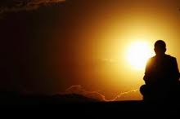
You will be for me a kingdom of priests – Exodus 19

Slide 9

Twelve springs and seventy palm trees – Exodus 15

Slide 10
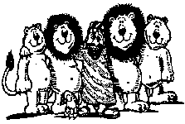
The God of Daniel – He is the living God – Daniel 2, 4, 6

Slide 11

Jonah’s story

Slide 12

Mustard seed . . . becomes a tree and the birds of the air come – Matthew 13

Slide 13

The kingdom of heaven is like a net that was let down into the lake and caught all kinds of fish. – Matthew 13:47

Slide 14

“The verse which demons memorize”
Matthew 24:14
Graphic: www.sodahead.com

Slide 15

There before me was a great multitude that no one could count, from every nation, tribe, people and language – Revelation 7

Slide 16
What was foretold in Genesis 12 (and repeated in Gen. 18:18, 22:17-18, 26:24 and 28:12-14) , John saw coming true in Revelation 7.

Slide 17
This PowerPoint presentation is available along with related materials and other PowerPoint presentations at http://home.snu.edu/~hculbert/ppt.htm

