Slide 1
Your spiritual priorities
A survey judging the priority you may be giving to aspects of the Christian life

Slide 2
Issues which were ranked
Worship
Distinctive lifestyle
Attitude toward ministry or spiritual matters
Fellowship
Giving
Personal Devotions
Lay ministry
Bible knowledge
Witnessing
Service
Social Justice
Missions

Slide 3
This survey does NOT . . .
Try to pinpoint weaknesses
Attempt to tell you how to improve yourself

Slide 4
Prioritize
“To arrange or deal with in order of importance”
    American Heritage Dictionary
Priority: Synonyms
  Precedence, Priority, Preeminence, Preference, Urgency

Slide 5
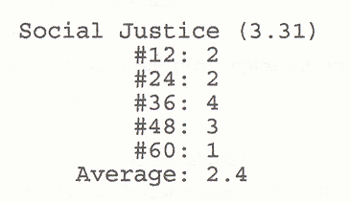
Feedback sheet
You responded to 5 statements related to each aspect
Example: “I encourage the church, or church members, to get involved in politics whether on a local, state or national level”

Slide 6
Feedback sheet
You gave each statement a numerical answer from 1 to 5
    1=Never
    5=Always
This is not Olympic competition where getting all 5s is the goal.

Slide 7
Feedback sheet
The level of importance (on a scale of 1 to 5) which you seem to be giving to each aspect is listed as your “Average:”

Slide 8
Feedback sheet
Numbers in parenthesis are average rankings from a wide sample of U.S. Christians

Slide 9
So, what use is this survey?

Slide 10
This PowerPoint presentation is available along with related materials and other PowerPoint presentations at http://home.snu.edu/~hculbert/ppt.htm

